Slide 1
Systems for Machine learning
Team: Heptagon

Slide 2
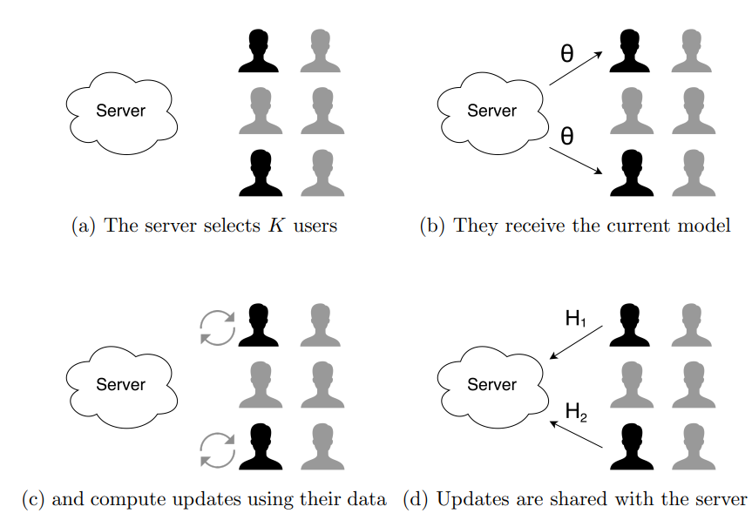
Background of Federated Learning
Client 12
Classes 10 (Mode l: CNN)

Slide 3
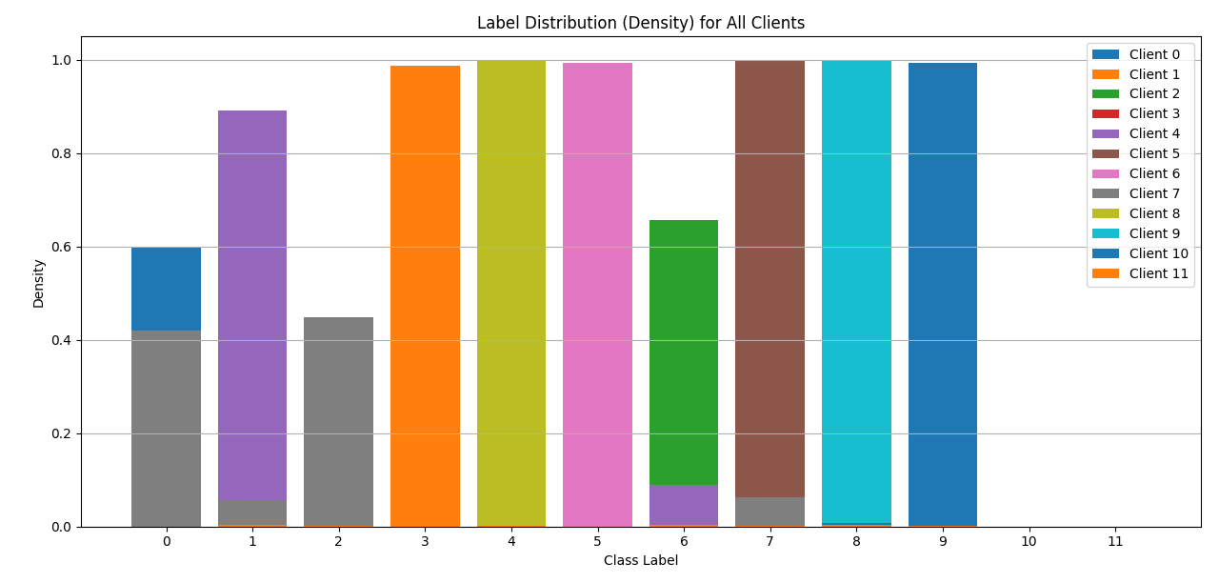
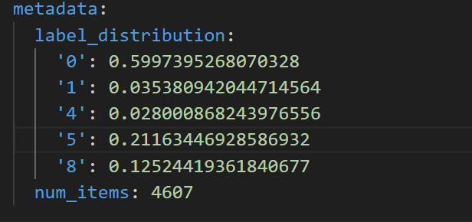
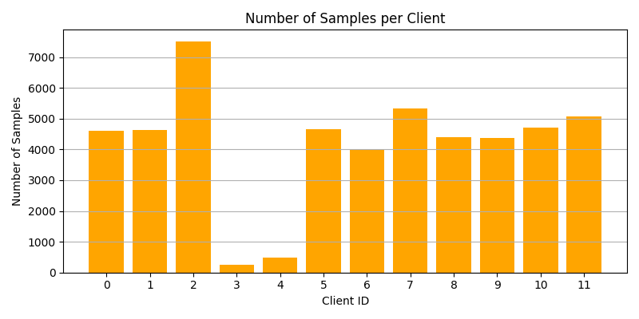
Data Analysis

Slide 4
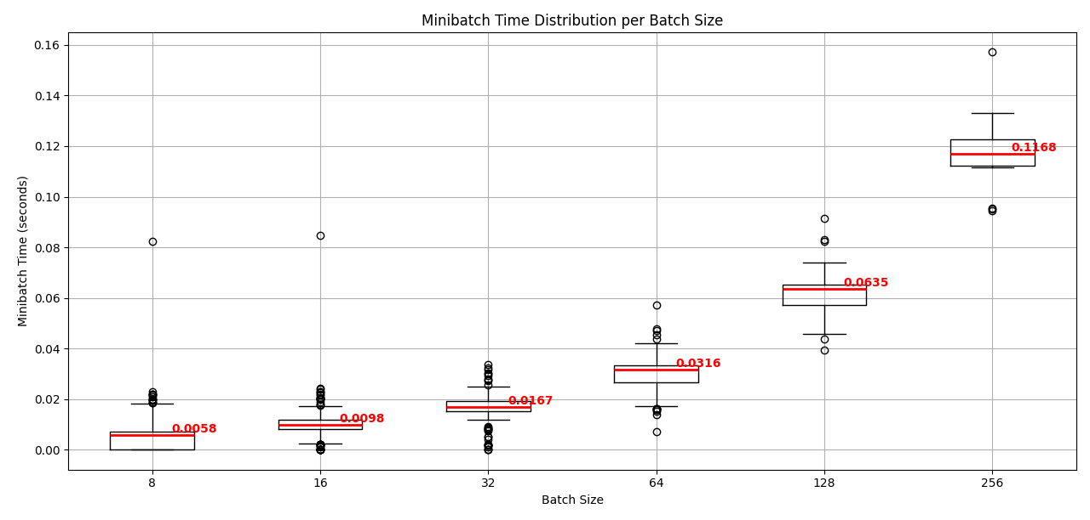
Ablation study, Memory used and Minibatch time

Slide 5
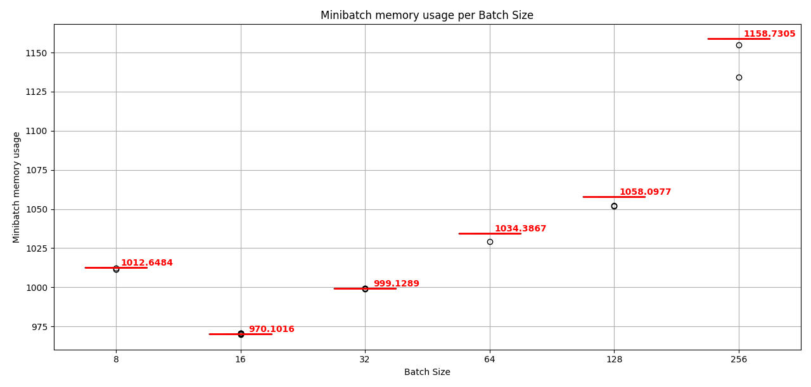
Ablation study, Memory used and Minibatch time

Slide 6
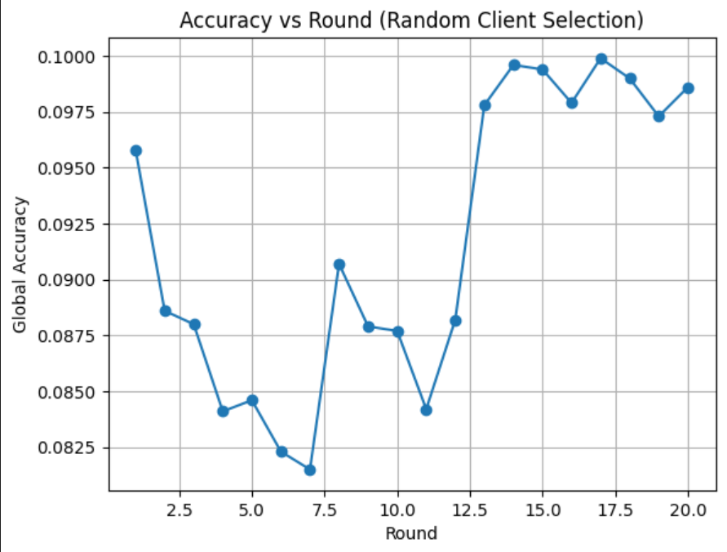
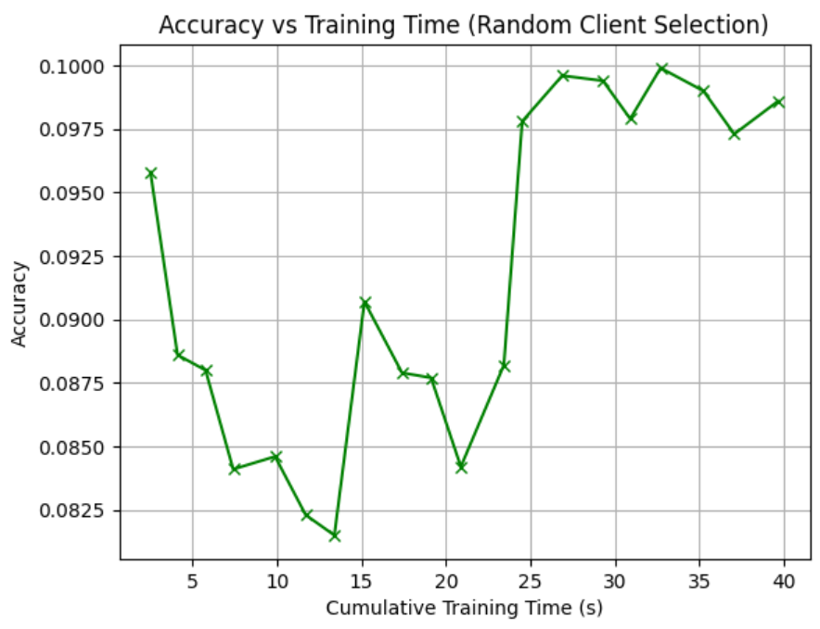
Random Selection

Slide 7
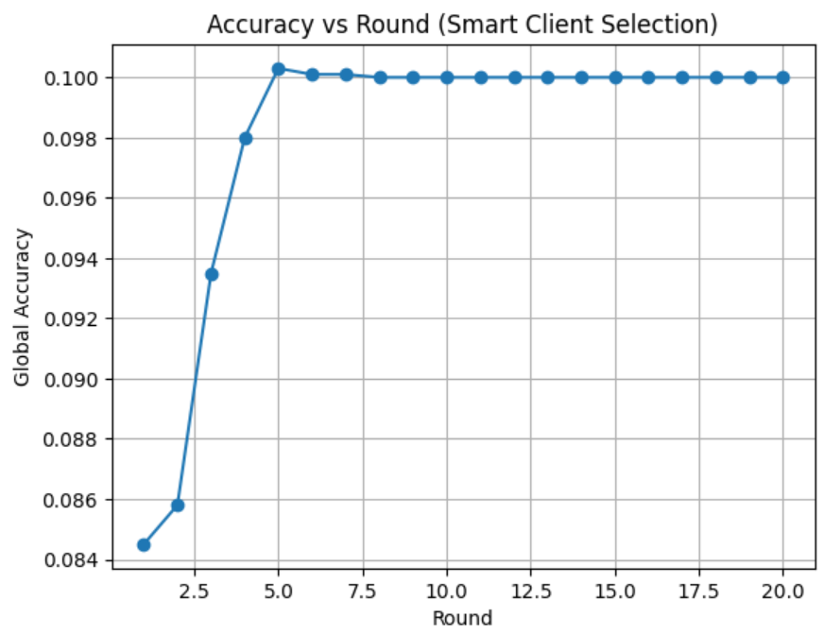
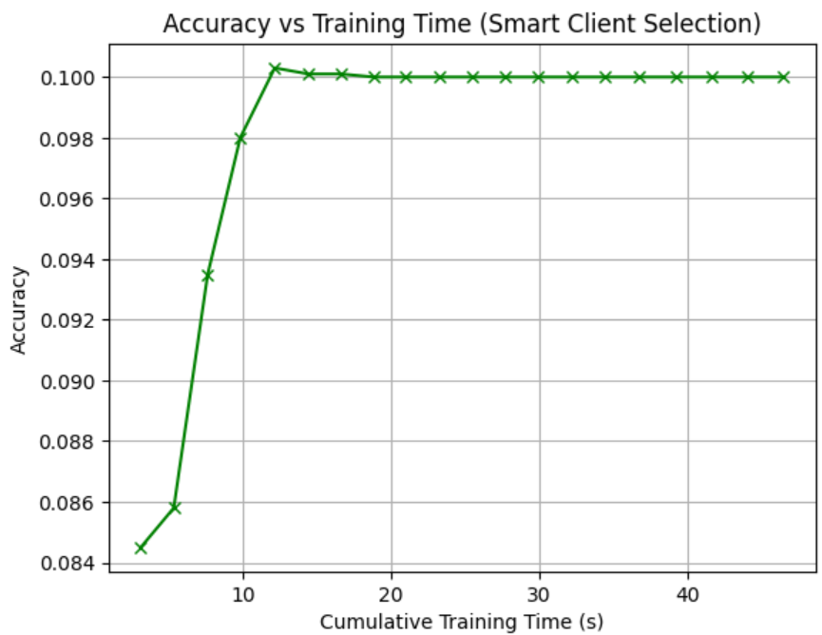
Smart Selection method

